Slide 1
Single Cell Progenitor Model
Huairen Zhang

Slide 2
1. Background
stem cell
differentiated cell
Cell division
+
p = r
p = 1 – 2 x r
p = r
lambda
+
+
N(stem cells)
N(stem cells) + N(differentiated cells)
rho =

Slide 3
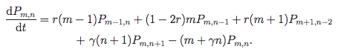
2. Method
1. Analytical Solution | 2. Simulation
Test for specific (r, rho) |  |  | pyABC
Clone size | 1 | 2 | 3 | 4 | 5 | 6 | ……
Probability | 0.38 | 0.41 | 0.12 | 0.06 | 0.02 | 0.005 | ……
likelihood = Σ { [ log(modelling probability) ] x (experimental frequency) }
distance function: quantile or KS

Slide 4
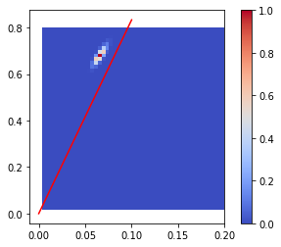
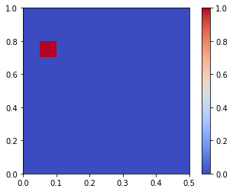
3. Result – Grid search for r and rho
Analytical solution | Simulation – loglikelihood | Simulation – distance | pyABC – KS

Slide 5
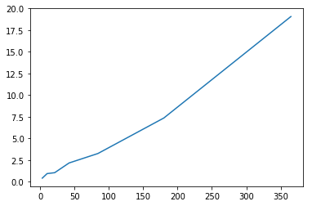
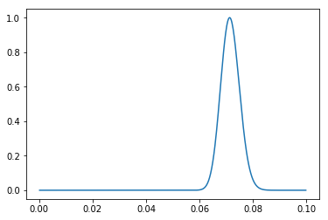
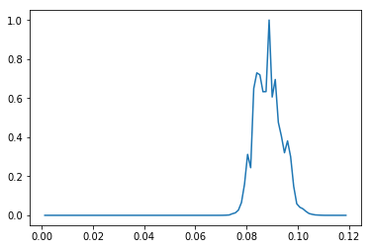
3. Result – Search for r with fixed r/rho
Constant r/rho
Result
average clone size against time
r/rho = slope/lambda
Analytical solution | Simulation – loglikelihood | Simulation – distance

Slide 6
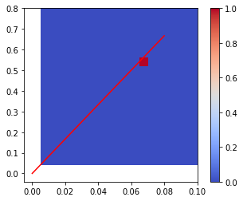
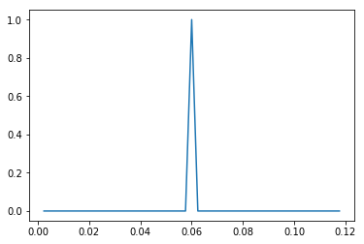
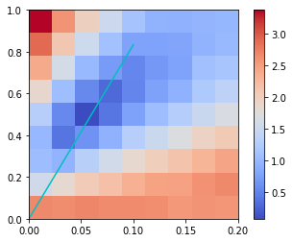
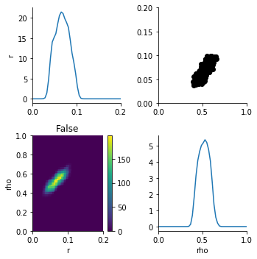
3. Result – Test with synthetic data
Synthetic data generated by simulation
Result
r = 0.060, expRate
average clone size against time
Analytical solution | Simulation – loglikelihood | Simulation – distance | pyABC – KS
(54 mins 102 mins 92 mins 56 mins)
Notes:
analytical solution, one (r,rho) takes 8 s
simulation – likelihood, one (r,rho) takes 2 mins
simulation – distance, one (r,rho) takes 1 mins

Slide 7
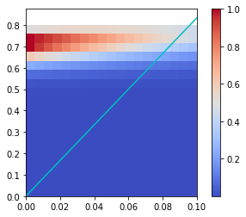
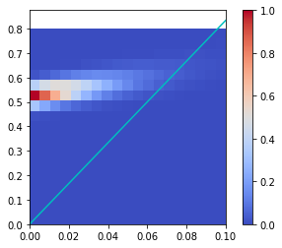
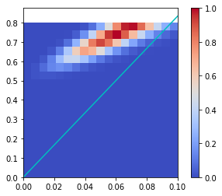
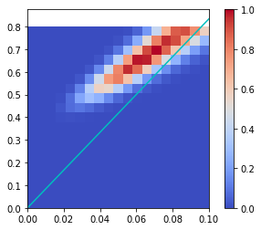
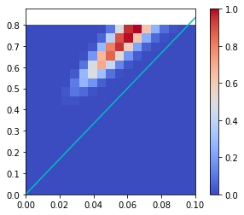
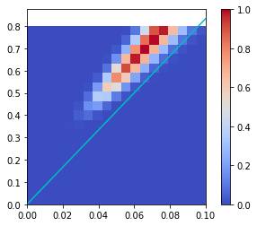
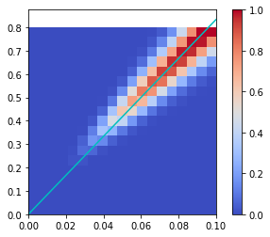
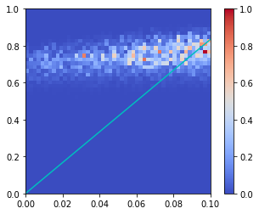
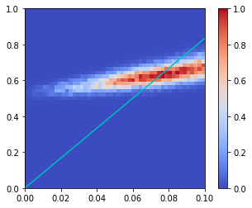
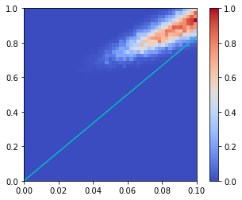
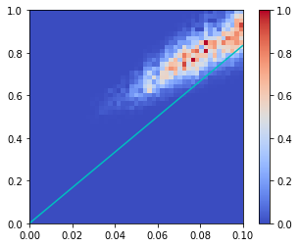
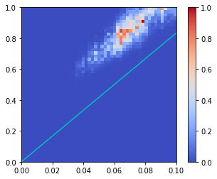
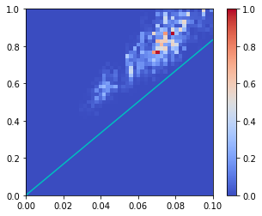
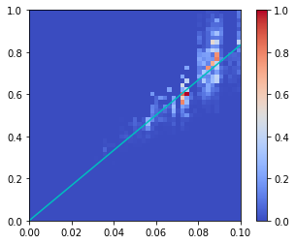
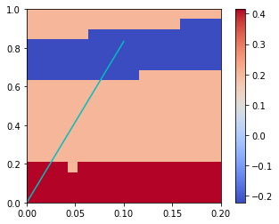
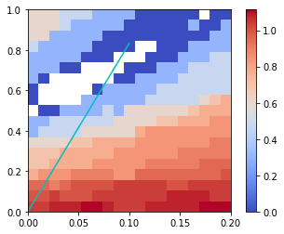
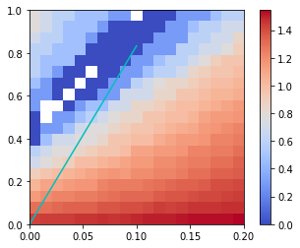
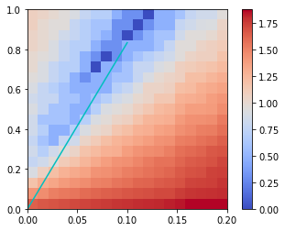
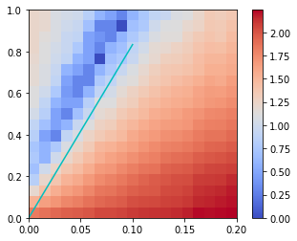
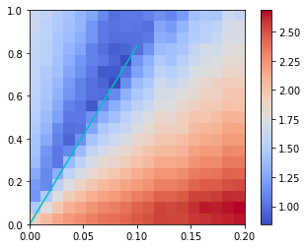
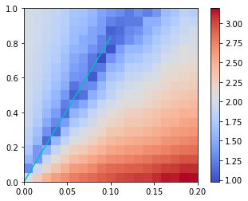
3. Result – Grid search at each time point
 | T = 0 | T = 1 | T = 2 | T = 3 | T = 4 | T = 5 | T = 6
Analytical Solution
Simulation – loglikelihood
Simulation – distance

Slide 8
4. Discussion – Analytical solution
Fail to test some (r, rho)

Slide 9
4. Discussion – Simulation & loglikelihood
Binning
loglikelihood
loglikelihood = 0 if p = 0, or
loglikelihood = log10(1/100,000) if p = 0
Clone size | 1 | 2 | 3 | 4 | 5 | 6 | ……
Probability | 0.38 | 0.41 | 0.12 | 0.06 | 0.02 | 0.005 | ……
original method
the size of each bin: 1, 1, 2, 4, 8, 16, 32,,,,
Clone size | 1 | 2 | 3 | 4 | 5 | 6 | ……
Probability | 0.38 | 0.41 | 0.12 | 0.06 | 0.02 | 0.005 | ……
updated method
the size of each bin: 1, 1, 3, 9, 27, 81,,,,
original method
updated method

Slide 10
4. Discussion – Simulation & loglikelihood
 | Synthetic data (r = 0.08, gamma) |  | Grid search of each timepoint
 | expRate | gammaRate | T = 0 | T = 1 | T = 2 | T = 3 | T = 4 | T = 5 | T = 6
Original method
Updated method

Slide 11
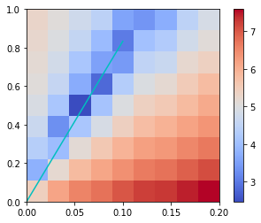
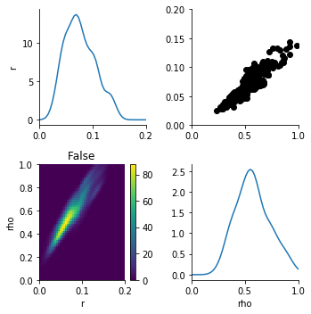
4. Discussion – Simulation & distance
synthetic data: r = 0.06
 | Grid search | pyABC
KS
Quantile

Slide 12
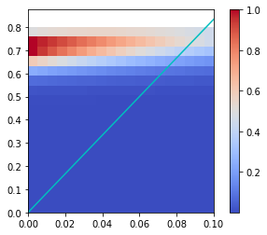
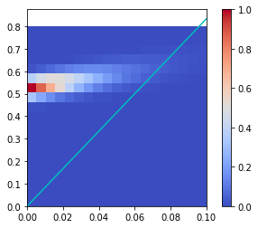
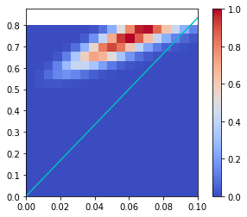
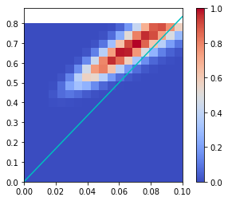
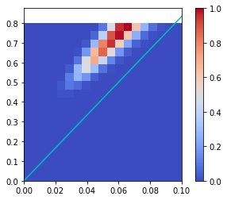
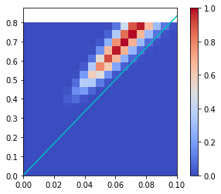
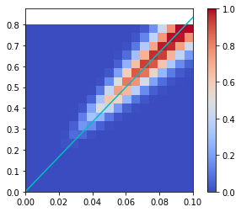
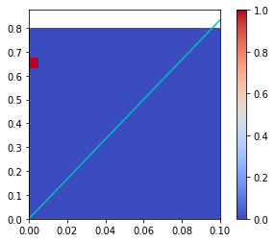
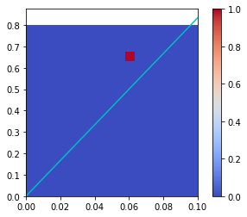


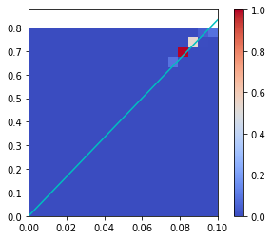
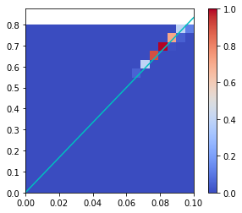
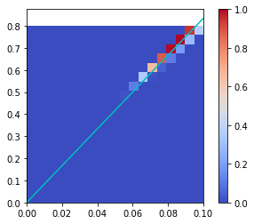
4. Discussion – Challenge
Difference between experimental data and synthetic data
 | T = 0 | T = 1 | T = 2 | T = 3 | T = 4 | T = 5 | T = 6
Experimental data
Synthetic data

